Slide 1
Smart Switch
What is the Smart Switch system?
What it gives the user?
What additional options are given to the user?

Slide 2
Today we will show you
Device and Architecture
Server side, API and Security
Client side and Web Site
System Demo view

Slide 3
The Smart Switch

Slide 4
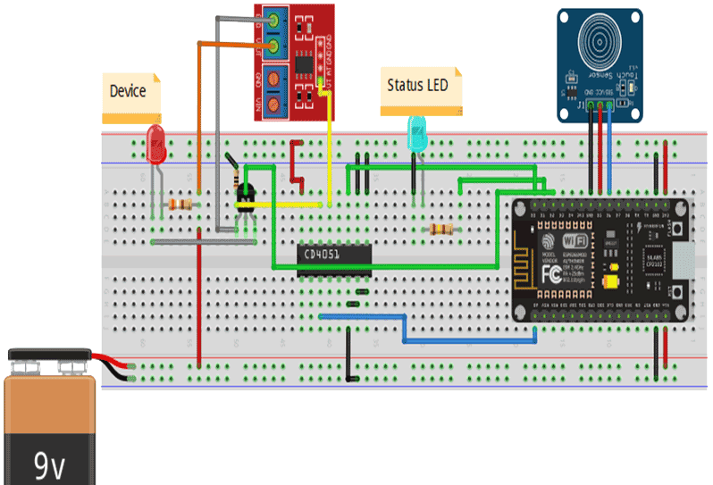
Design

Slide 5
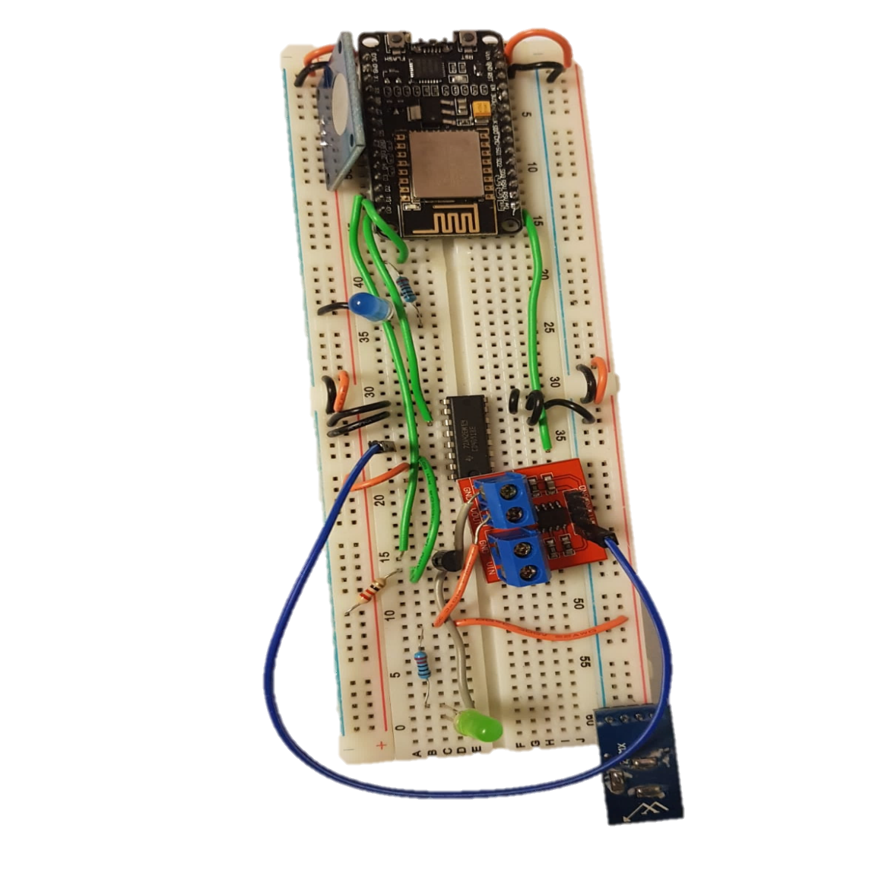
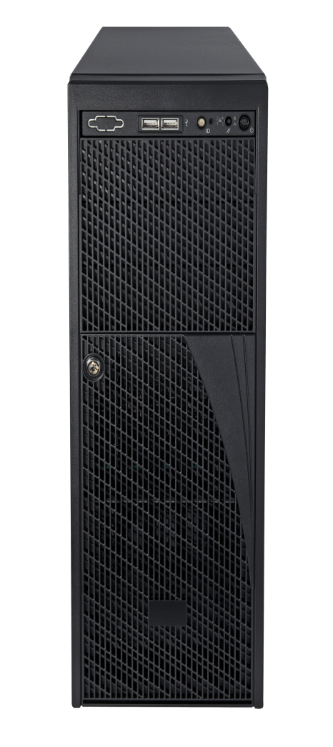
Server communication
Websockets

Slide 6
Web API

Slide 7


ASP.NET Core RESTful API
Easily recognizable per REST standards
Uses DTOs for efficient data transmission
Numbered errors for efficient error handling
Plugs
Turn on/off
Change properties
Samples
Get samples of a given plug during a specified period
Tasks
Schedule periodic/single tasks (e.g. turn off in 5 minutes, turn on every morning)
A well-documented JavaScript API was built

Slide 8

security
registration
Authentication
Authorization

Slide 9
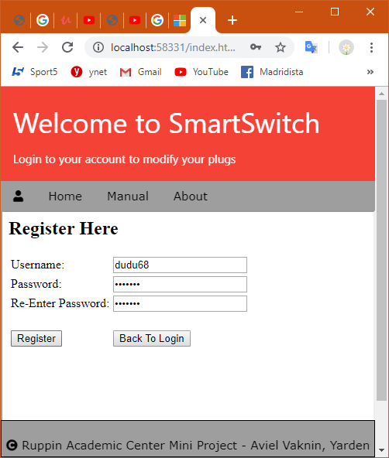
registration
Valid user name
Valid password
user data saved in server’s data base

Slide 10
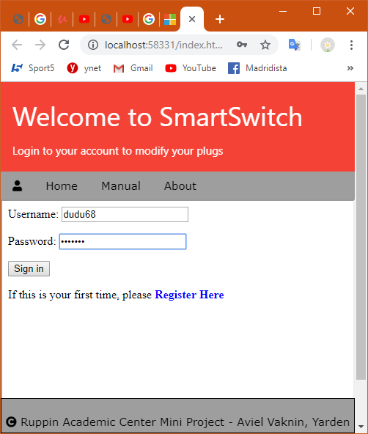
Sign in
Client user enter username & password
Server validate
Jwt token generation
Server & client keep the unique token string

Slide 11
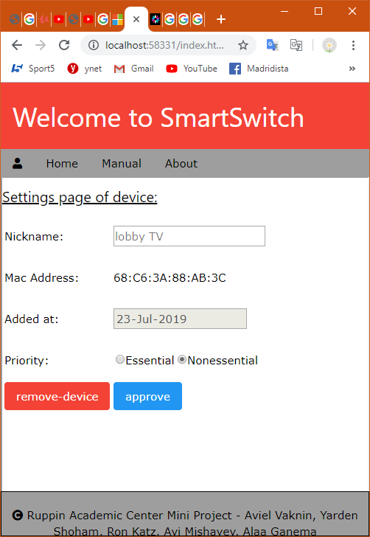
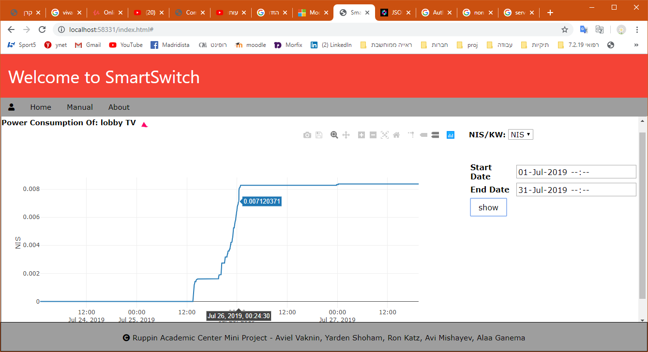
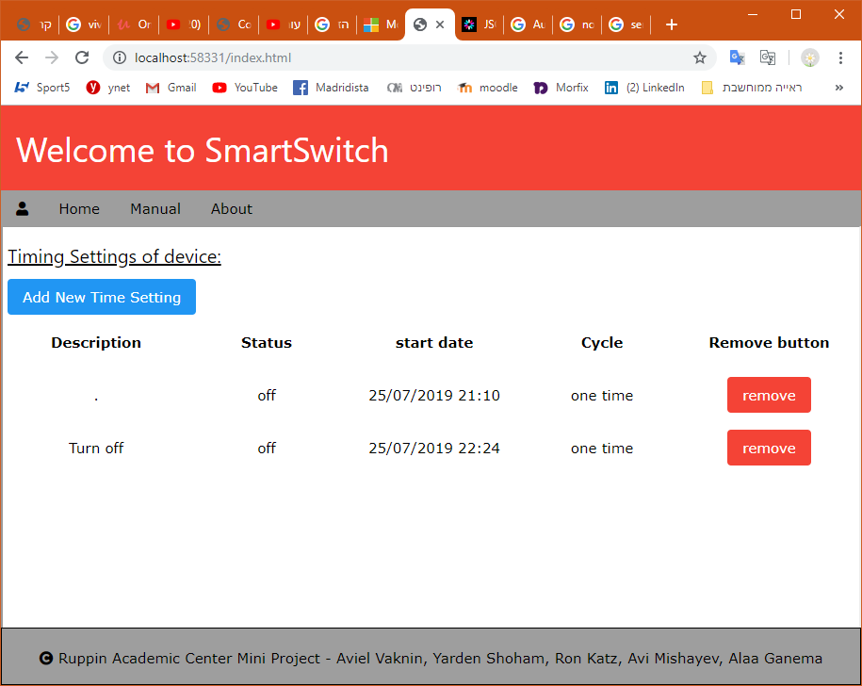
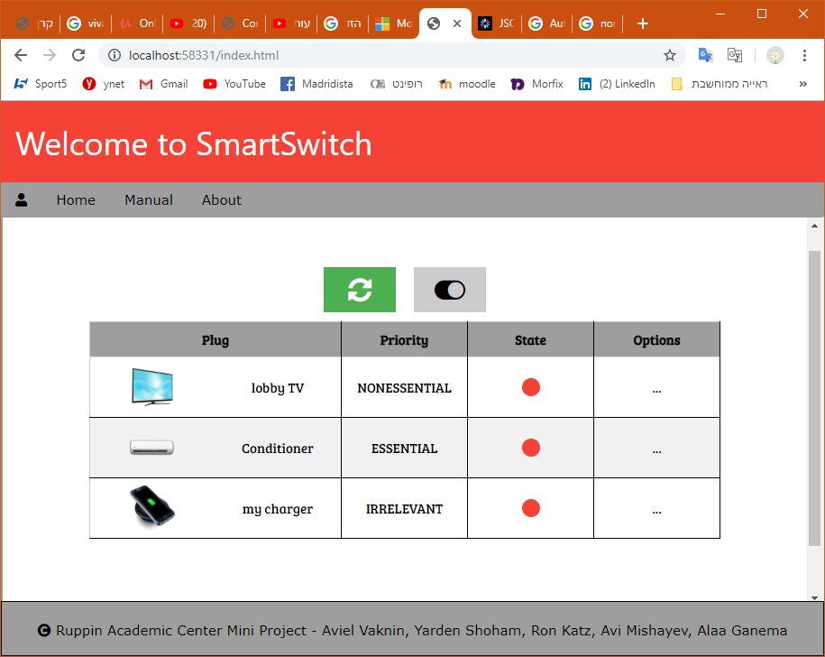
authorization

Slide 12
Front-end
The big picture
How we implemented moving between pages
Using an iframe object
How we transfer data from one page to another
Session storage
Using sidebar as a logged in account
The Sidebar is changing after logging

Slide 13
Front-end
The big picture
Advantages
The surroundings of the main Div is not changing
Session storage cleans up at the end of every session
Using sidebar we get a more comfortable UI

Slide 14
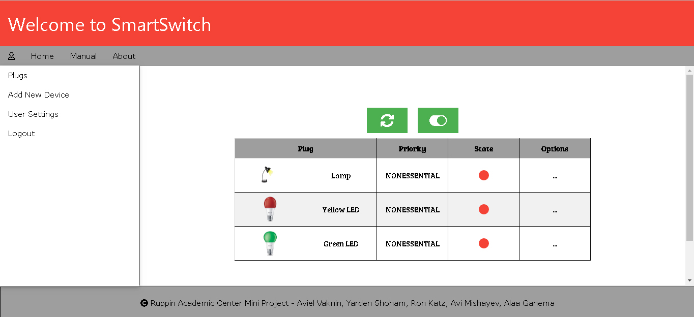
Front-end
Home Page when logging in
Each row matches one specific plug that the client owns and approved

Slide 15
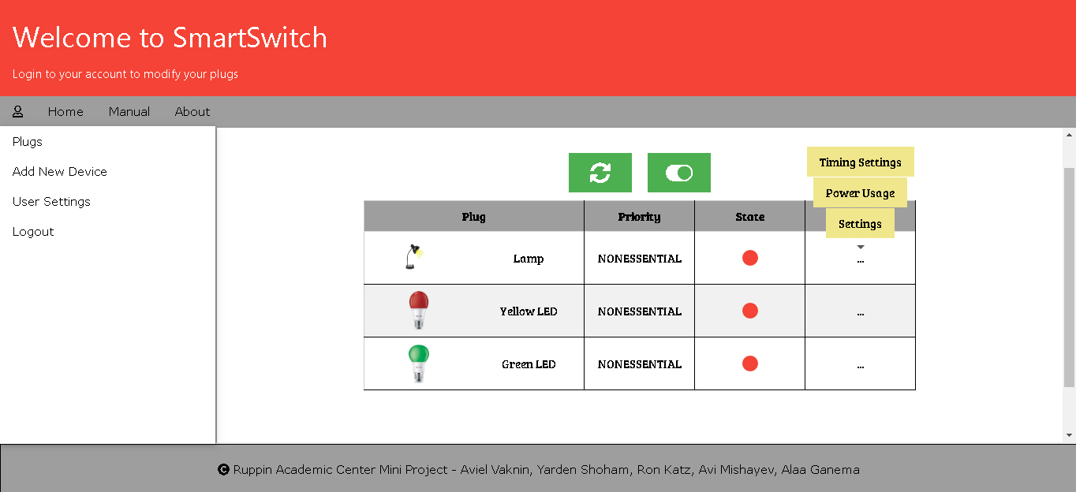
Front-end
The 3 buttons menu…

Slide 16
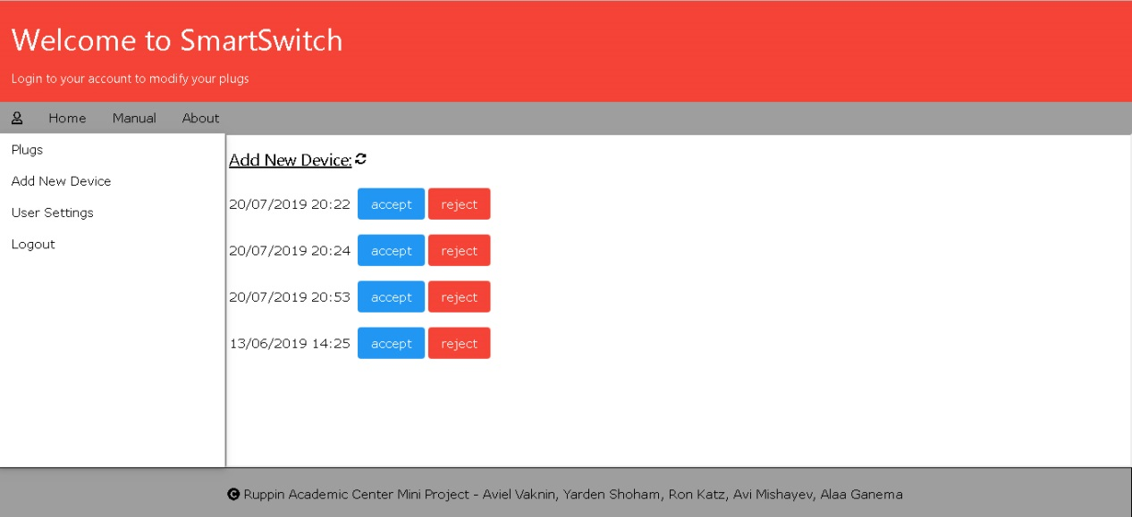
Add new device
Page elements and functionalities:
Present all unapproved plugs for the client as viable options
An “reject” button, which removes the unapproved plug as viable option for the client
A “refresh” button, which loads the page on click

Slide 17
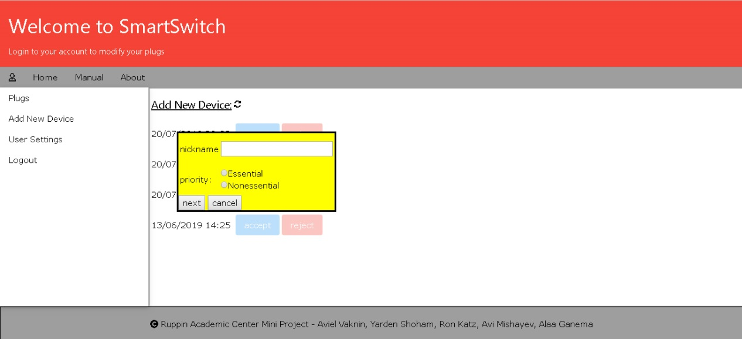
Add new device
Page elements and functionalities:
Present a popup by choosing a certain unapproved plug, by clicking the “accept” button
Using said popup, the client determines the settings of the chosen plug
Conveying the client’s choices to the database and updating the page accordingly by clicking the “next” button from the popup
Removing the popup by clicking on the “cancel” button ,which is located on said popup

Slide 18
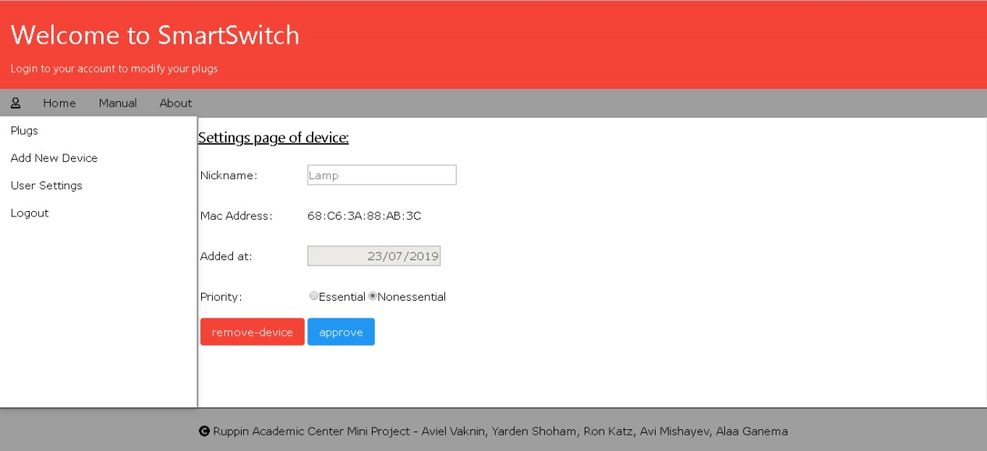
Device Settings
Page elements and functionalities:
Present the current settings of the chosen plug, including the date of its arrival to the database and it’s mac address (which are unchangeable)
An option to change the current nickname of the chosen plug
An option to change the current plug’s priority
An “approve” button, which conveys the client changes to the database
An “remove-device” button, which removes the chosen plug from the client’s approved plugs, removes the plug from the database and updates the page accordingly by returning to the plugs Main Viewer page

Slide 19
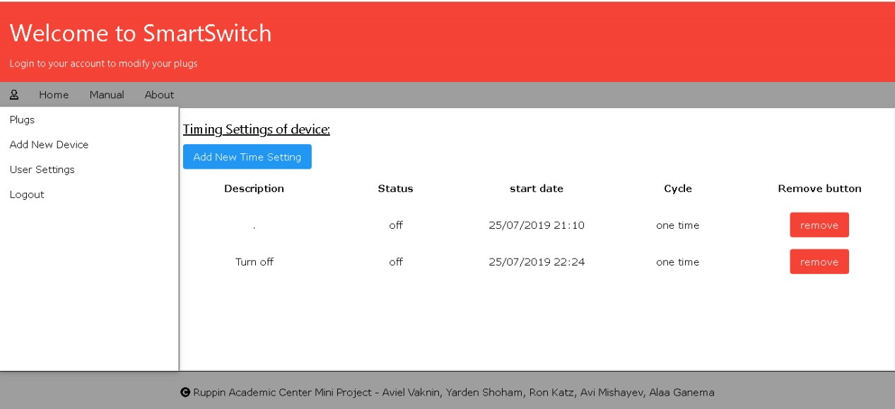
Timing settings
current’s plug already created tasks and their settings
“Add New Timing Setting” button

Slide 20
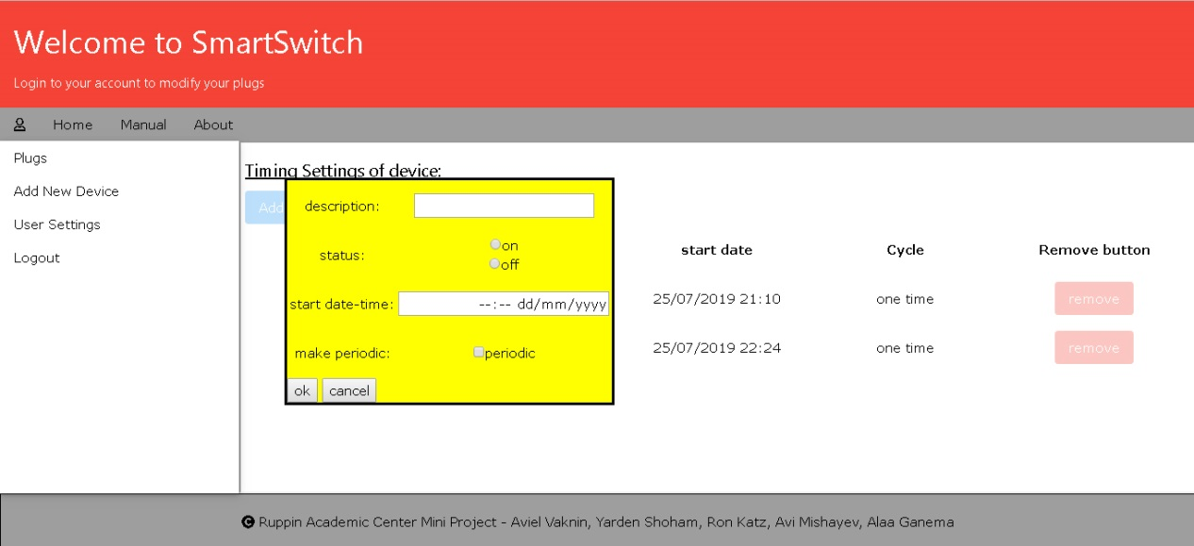
Timing settings
The database and the page accordingly updates by clicking the “ok” button
The client determines the settings of the new task

Slide 21
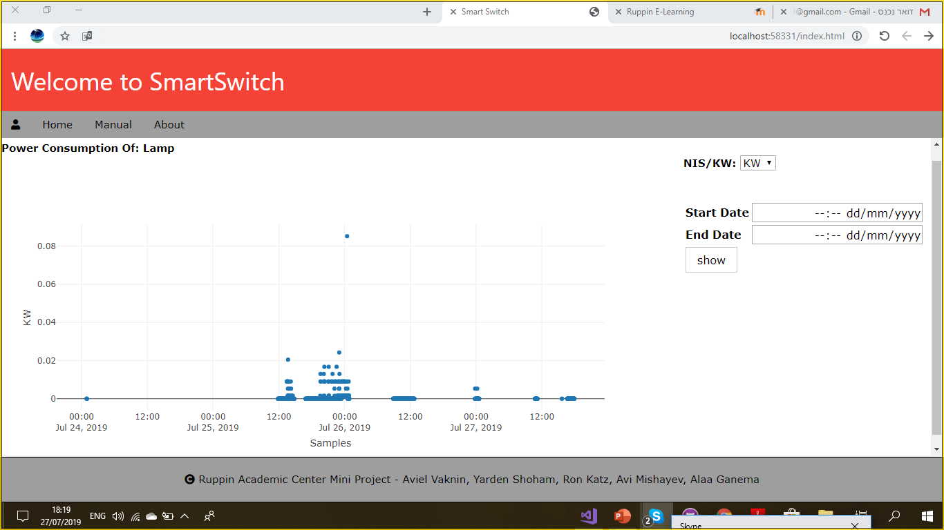
Power consumption
In this page we can see power consumption of the device we entered with it this page. When we arrive this page
a graph will be display to the user that show the power consumption in KW

Slide 22
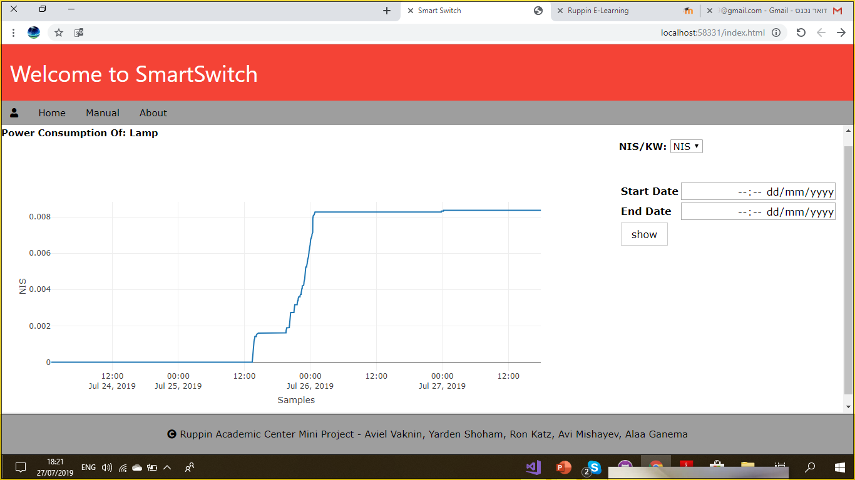
Power consumption
In this page we can see how much did it cost using this device according to the power and the cost of one KW

Slide 23
Live demo

Slide 24
summary
Thank you for listening……

